Slide 1

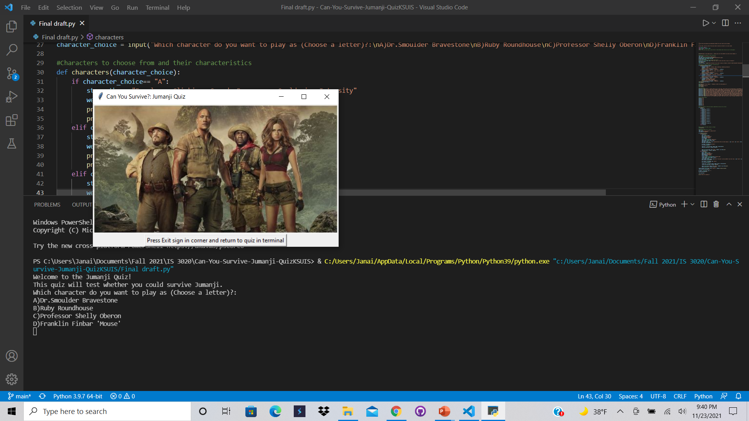
Can You Survive?: Jumanji Quiz
A simple quiz to test whether users can survive Jumanji; based off of the film, Jumanji: Welcome to the Jungle.
By: Janai Hemphill
Github Repository: https://github.com/ksu-is/Can-You-Survive-Jumanji-Quiz

